Slide 1
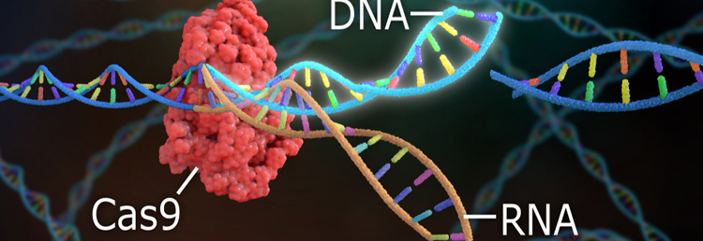
Genome Editing: Crispr–CAS9
Amal Sharma
21st March

Slide 2
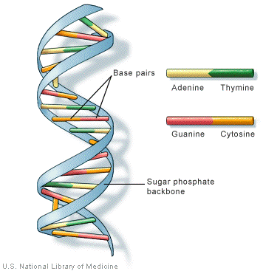
Important terms
DNA - deoxyribonucleic acid, is the hereditary material in humans. The information in DNA is stored as a code made up of four chemical bases: adenine (A), guanine (G), cytosine (C), and thymine (T). An organism's genetic information is encoded as a linear sequence of bases in the cell's DNA. Human DNA has around 3 billion bases and order of these bases determines the information available for building and maintaining an organism
RNA - Ribonucleic acid, is principally involved in the synthesis of proteins, carrying the messenger instructions from DNA, which itself contains the genetic instructions required for the development and maintenance of life
Genome Editing – It is a technique that enables medical researchers to edit parts of the genome by removing, adding or altering sections of the DNA sequence. Human genome is made up of 20,000 genes
CRISPR – stands for Clustered regularly interspaced short palindromic repeats. It is a genome editing technique which utilizes protein Cas9 that acts like a pair of molecular scissors, capable of cutting strands of DNA.

Slide 3
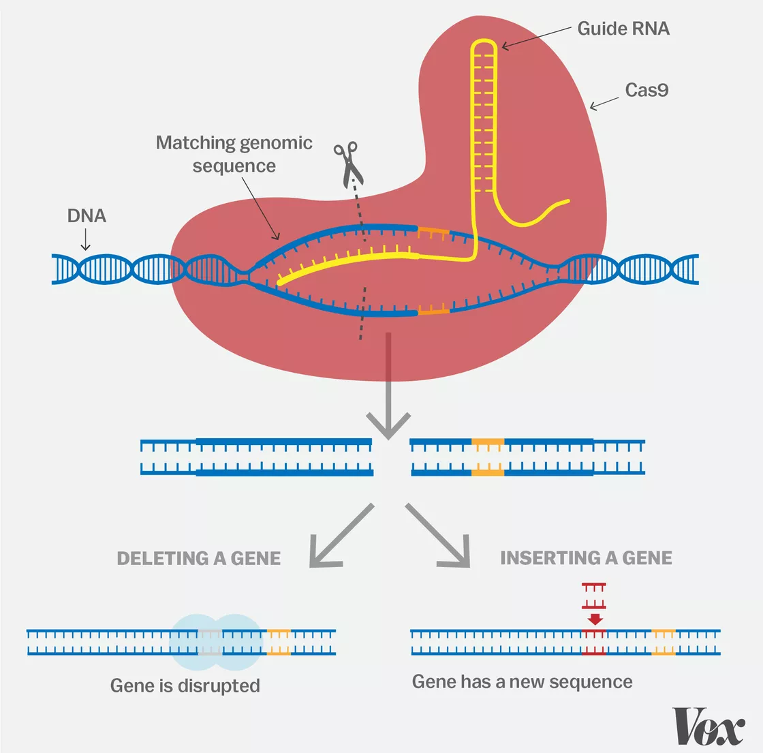
How CRISPR Works
Researchers create a small piece of RNA with a short “guide” sequence that attaches to a specific target sequence of DNA in a genome. The RNA also binds to the Cas9 enzyme; as in bacteria, the modified RNA is used to recognize the DNA sequence, and the Cas9 enzyme cuts the DNA at the targeted location. Once the DNA is cut, the researchers use the cell’s own DNA repair machinery to add or delete pieces of genetic material, or to make changes to the DNA by replacing an existing segment with a customized DNA sequence.
Goal:
Edit crops to be more nutritious
New tools to stop genetic diseases
Powerful new antibiotics and antivirals
Gene drives that could alter entire species

Slide 4
How Machine Learning can help
CRISPR modification are extremely premature and can inadvertently wipe out and rearrange large swaths of DNA or even trigger cancer. Collating data points from CRISPR experiments and adding them to machine learning algorithms will further improve an AI system’s accuracy. Predicting the guide performance for different target sequences allows the adjustment of the total number of guides necessary, which maximizes results and lowers costs—and minimizes undesired side effects.
Off-target Score: It is an indicator of specificity, estimates the off-target effects which are the number of changes occurring at locations away from the desired target. Imagine we have decided to cut a gene in a particular place — I need to know if I am also going to accidentally cut the genome in other places and thereby have a potentially bad side effect

Slide 5
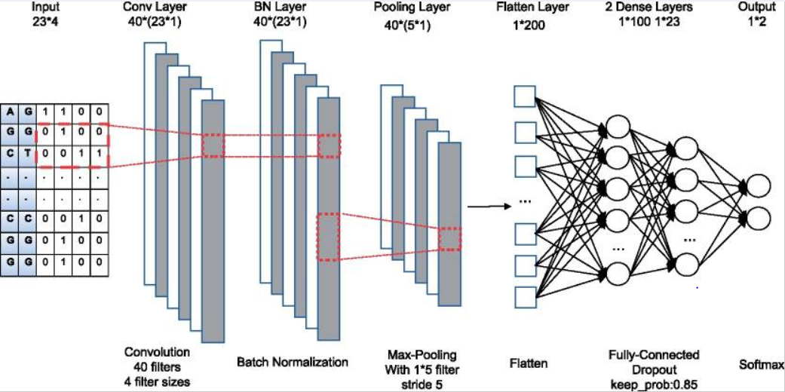
Neural Networks & Off-target Prediction
The input of this neural network is the encoded RNA-DNA sequence with length 23. The BN layer is used to normalize the output of the convolutional layer to speed up learning and avoid over-fitting. The outputs of max-pooling layer are joined together into one vector by flattening. Each neurons in the flatten layer is fully connected to the first dense layer. The second dense layers with a drop-out layer is fully connected to two output neurons to predict whether the input pair is off-target or not.

Slide 6
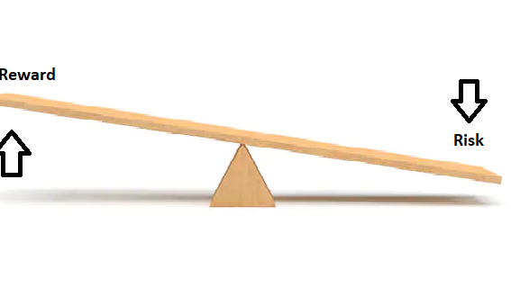
Do the risks outweigh the rewards…?
Many scientists are advocating to keep the conversation about this technology open & transparent and build public trust
We need to grapple with all the ethical considerations at play here. For example, if we edited a gene, future generations wouldn’t be able to opt out and it might be difficult to undo its effect

Slide 7

Thank You
CRISPR has the potential to transform the world yet at the same time, it need to be tempered through thoughtful best practices and mundane practicalities so choose wise..!!

